Slide 1
Technikon Web
Alexandros Aristeridis

Slide 2
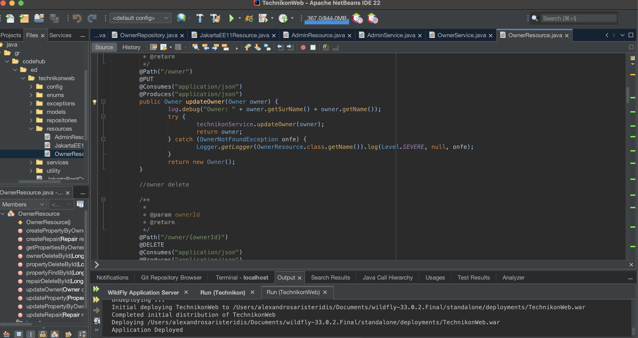
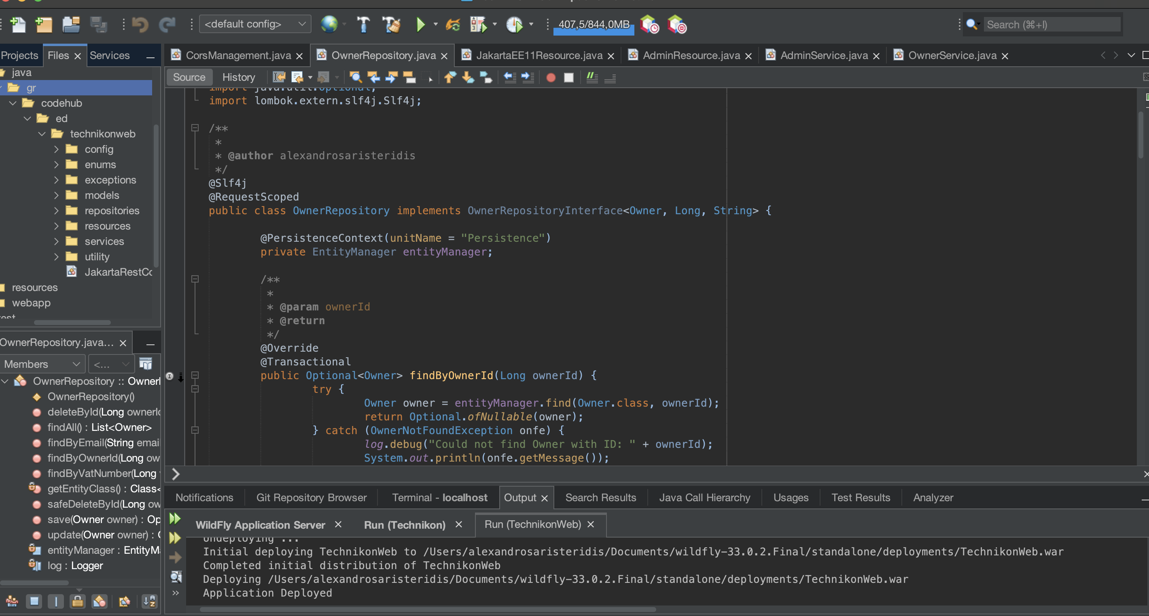
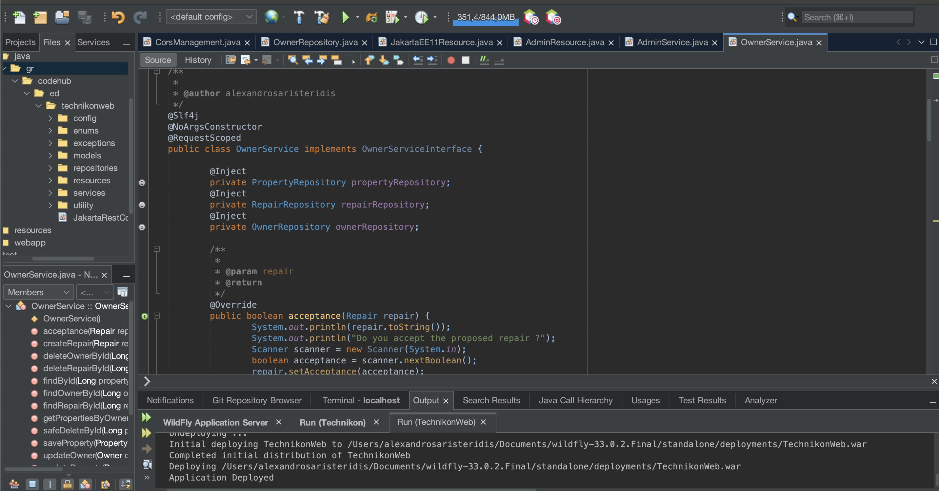
Technikon Web
Update Technikon from a Java application to Web application using Jakarta RESTful web services

Slide 3
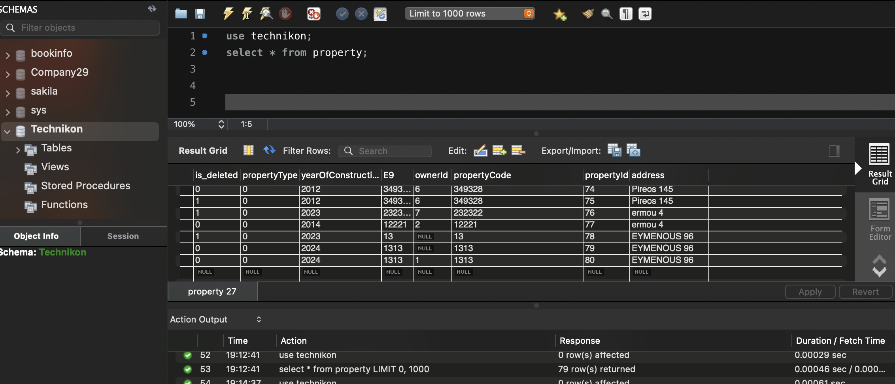
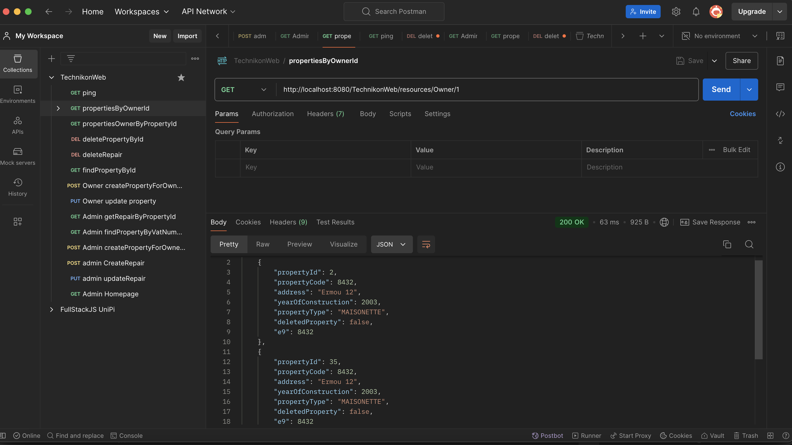
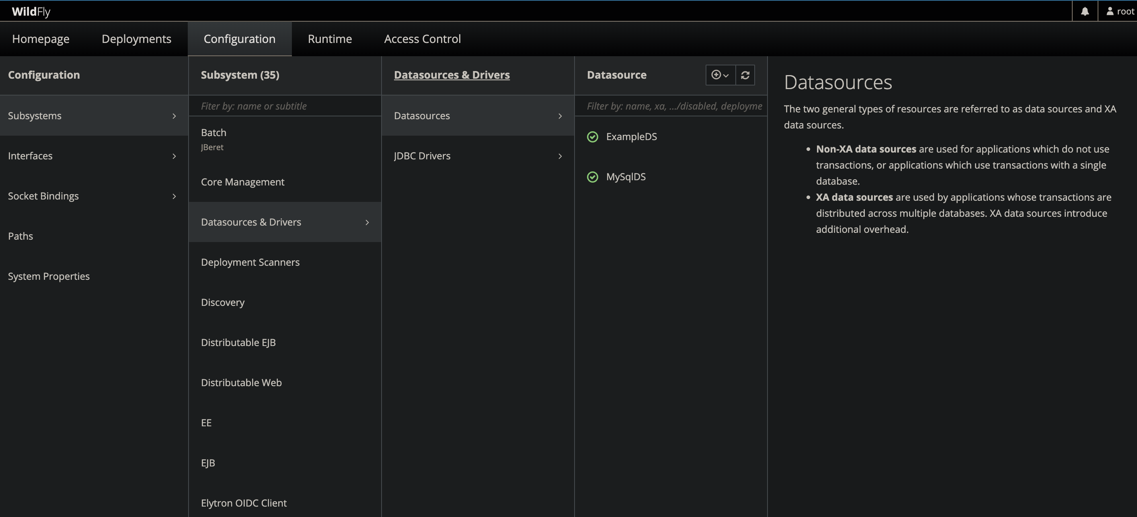
Technikon Web
Uses wildFly to deploy Jakarta application and Postman to test the API

Slide 4
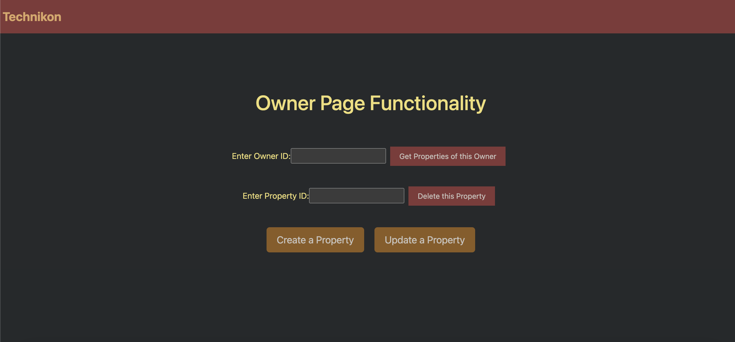
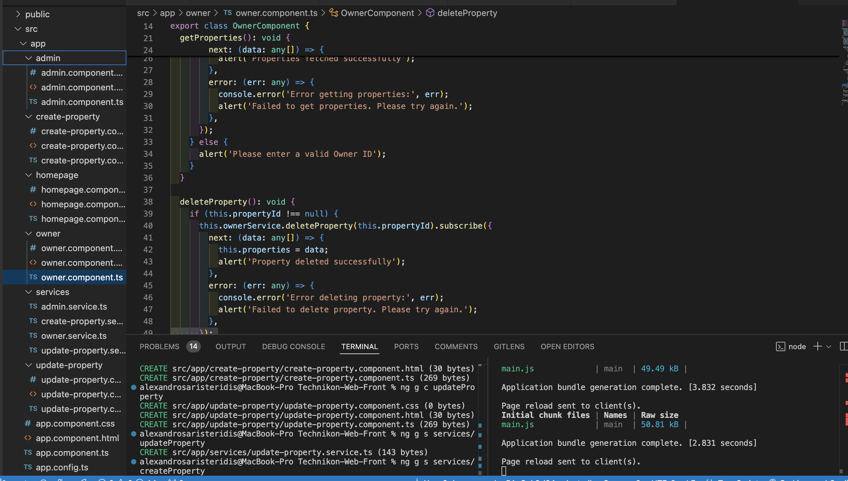
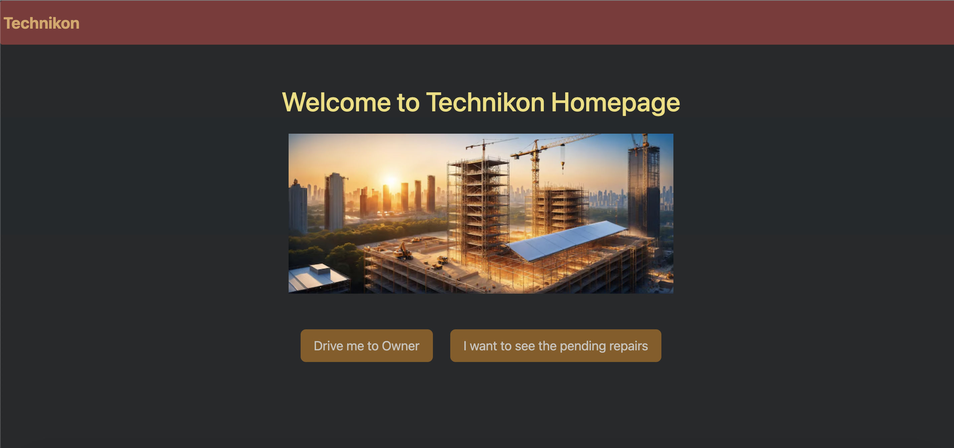
Technikon Web
Used Angular for the front end

Slide 5
Technikon Web
Thank you!

